Slide 1
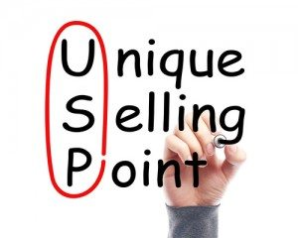
Unique Selling Point (USP)

Slide 2

Soft Skills Definition:
Intrapersonal and interpersonal behavior that develop and maximize human performance.

Slide 3
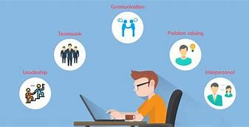
Soft Skills:
Effective Communication
Effective Leadership
Conflict Resolution
Problem Solving Strategies
Dealing with Difficult People
Presentation Skills
Stress Management
Time Management and Organizational Skills
Team Leadership
Multicultural Competency

Slide 4
How Will You Use Your USP In Job Search?
Short Professional Statement (SPS).
STARS
“Why should I hire you?”

Slide 5

What makes YOU stand out?
What have people told you they are impressed with?
What have you done that has improved the team?
How do your soft skills connect to the job description?

Slide 6
Examples of USP:
“I have strong multicultural competency skills and work well in a diverse setting.”
“I implement feedback efficiently and effectively.”
“I am a quick learner and enjoy learning new technologies.”
“I manage high-stress situations well and can perform well under pressure.”

